Slide 1
World News Headlines at a Glance
Top Keywords for news in countries around the world!

Slide 2
Agenda
Our Approach
What We Built, What Does it Do
Our Process / Back-End Processing
Demonstration

Slide 3
Our Approach
Assumption:
By treating countries top headlines as meaningful lists of keywords we can derive important topics through aggregate analysis of those words lists.
Using simple word counting and keyword extraction algorithms we can provide meaningful information about the world news each day and over time.

Slide 4
What does it actually do?
Our application:
Allows users to explore top headlines from around the world and create their own mental narrative.
Allows users to see analyze multiple countries headlines or visualize the world as a whole with multiple visualizations.
Allows users to make connection between countries and their stories.

Slide 5
Our Process – Back-End
Data Mining:
Calling Reuters News API* daily for the top headlines by categorized by country.
CreateDB.py Initializes the Mongo database.
Update.py processes news headlines, as a scheduled task daily.
*https://newsapi.org)

Slide 6
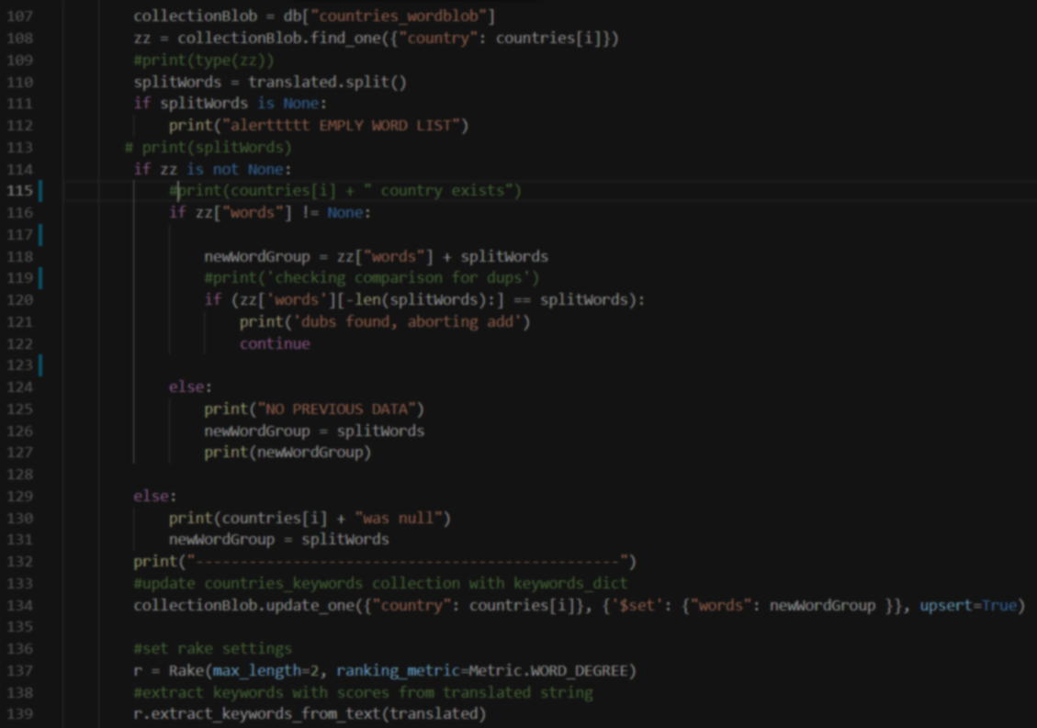
Back-End
Update.py performs the following functions daily
Concatenates all headlines per country that day.
Translates each countries headlines using translate.google.com API calls via the py_translator module
Strips meaningless special characters (and the flame emoji 🔥)
Performs analysis (keyword extraction)
Stores all derived and original data in a Mongo database

Slide 7
Processing Data
Rake NLTK
Rake Calculates word associations and “magnitude” of associations for 1 or 2 words.

Slide 8
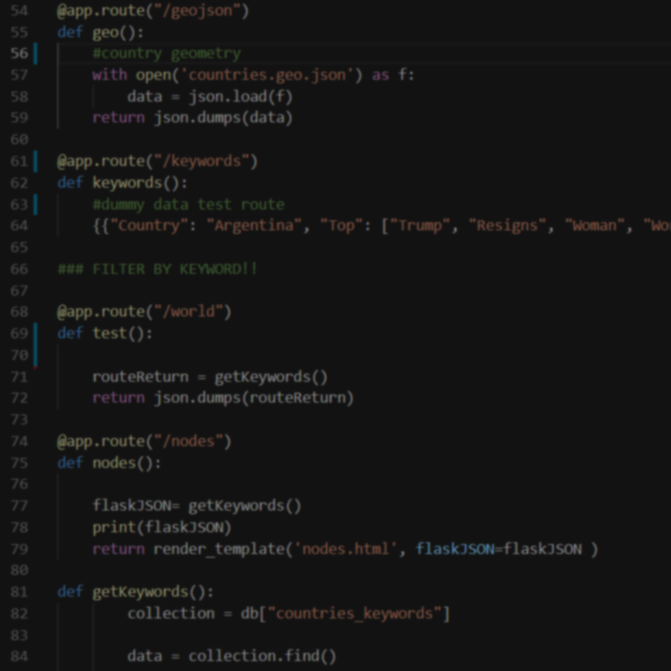
Back-End Cont.
The application appRoutes.py
3 tier application provides all data and services to the front end through API calls.
Flask app provides routes for several visualization pages and many API end points.

Slide 9
Presentation
Visualizations and Interactive Analysis
Map
Network
Dashboard

Slide 10
App Demo
Add link to application here

Slide 11
Post Mortem
What would we do next…
Heroku Deployment.
Deeper analysis of word collections by network analysis.
Word Searching
Linking to actual Articles
…

Slide 12
Backup Slides “Dead Demo”
Map (leaflet)
MAP GOES HERE

Slide 13
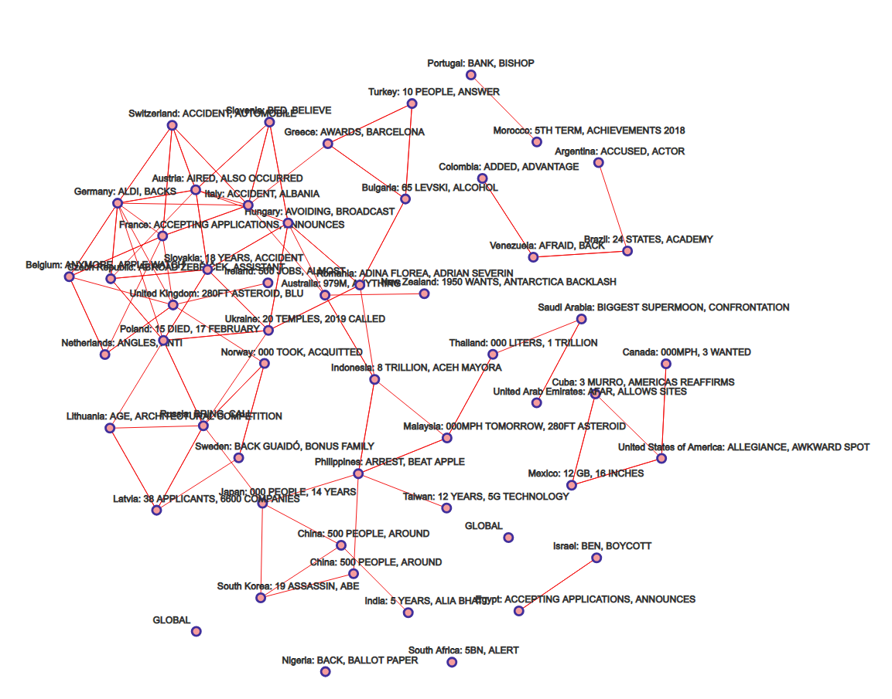
Backup Slides
Node Network
Key statements on what this does

Slide 14
Coel’s View
Add picture of image
Add text around what this does

Slide 15
Bar Graph
Add image
Add text about what this does

Slide 16
Network Connection
Add image
Add text about what this does

Slide 17
Backup Slides
Dashboard
GRAPHS AND CHARTS

